Slide 1
Subset construction by Lazy evaluation scheme to convert NFA to DFA
By:
Vivek Jadhav 2GI19CS185
Venkatesh Dhongadi 2GI19CS175
Vinayak Bhandage 2GI19CS179
Suyash Rawool 2GI19CS161

Slide 2
INTRODUCTION
Lazy evaluation is an evaluation strategy which holds the evaluation of an expression until its value is needed. It avoids repeated evaluation.

Slide 3
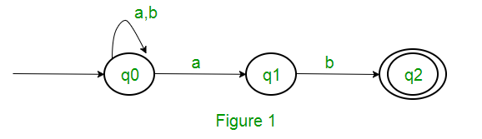
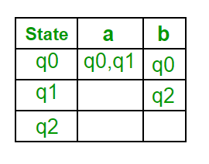
EXAMPLE
Consider the following NFA shown in Figure 1
Following are the various parameters for NFA. Q = { q0, q1, q2 } ∑ = ( a, b ) F = { q2 } δ (Transition Function of NFA)

Slide 4
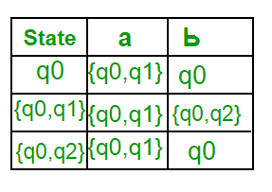
After solving we find that there is no new state generated. So, The final state of DFA will be state which has q2 as its component i.e., { q0, q2 }
Following are the various parameters for DFA. Q’ = { q0, { q0, q1 }, { q0, q2 } } ∑ = ( a, b ) F = { { q0, q2 } }

Slide 5
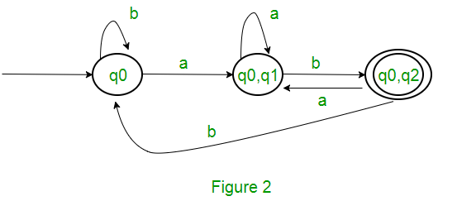
The final DFA for above NFA is

Slide 6
ADVANTAGES
It allows the language runtime to discard sub-expressions that are not directly linked to the final result of the expression.
It reduces the time complexity of an algorithm by discarding the temporary computations and conditionals.
It allows the programmer to access components of data structures out-of-order after initializing them, as long as they are free from any circular dependencies.
It is best suited for loading data which will be infrequently accessed.
It has the ability to define potentially infinite data structures. This allows for more straightforward implementation of some algorithms.

Slide 7
DRAWBACKS
It forces the language runtime to hold the evaluation of sub-expressions until it is required in the final result by creating thunks (delayed objects).
Sometimes it increases space complexity of an algorithm.
It is very difficult to find its performance because it contains thunks of expressions before their execution.

Slide 8
CONCLUSION
Lazy evaluation is much more efficient than subset construction in terms of both number of states in final DFA and also number of steps required to convert NFA to DFA.

Slide 9
THANK YOU!

